Slide 1
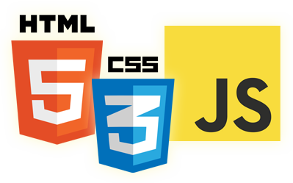


JavaScript Language
Eyal Vardi
Microsoft MVP ASP.NET blog: eyalvardi.wordpress.com

Slide 2
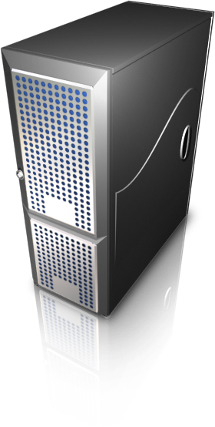
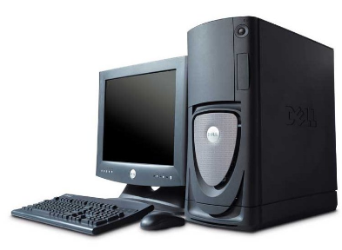

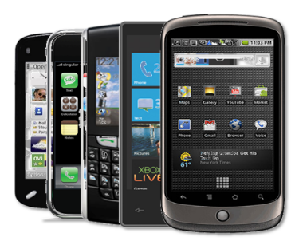



The Challenge
Notes:
OS
Screen Resolution
Deployment
Security
Browsers
Load Balance

Slide 3
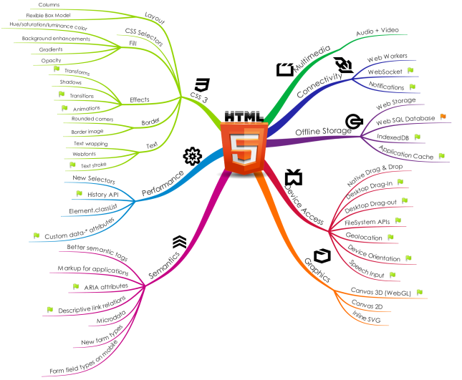
HTML 5 )Changes The Rules of The Game(

Slide 4


Traditional apps
Browser Request
Index.html
MVC4
Traditional Request / Response for ALL rendered content and assets

Slide 5
Web Application (SPA)
Initial Request
Application.htm
RequireJS Loader
Application.js (bootstrap)
MVC4
Page1 Partial.htm
ViewModel (#index)
IndexViewModel.js
ViewModel (#login)
JSON Requests
Model (LoginModel)
Handling disconnection
HTML5 localstorage

Slide 6
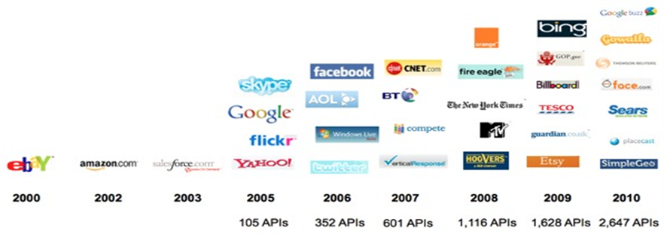
Web API Growth
Source: www.programmableweb.com – current APIs: 4,535

Slide 7

Single Page Web Apps (SPA)

Slide 8
Agenda
JavaScript History
Syntax
Data types
Flow-control
Functions

Slide 9
JavaScript History

Slide 10
In The Beginning...
In 1995 Netscape hired a young lad by the name of Brenden Eich to take charge of designing a new language.
Eich decided to create a loosly-typed scripting language that will appeal to web developers.
By December of 1995 'LiveScript' is born! (and quickly renamed 'JavaScript')

Slide 11
Standardization
With the mess created by IE3's JScript Netscape, Sun and ECMA decide to standardize JavaScript and create 'ECMAScript‘.
In the meantime, Netscape and Microsoft releases the '4.0' browser generation, each with its own implementation of the DOM.

Slide 12
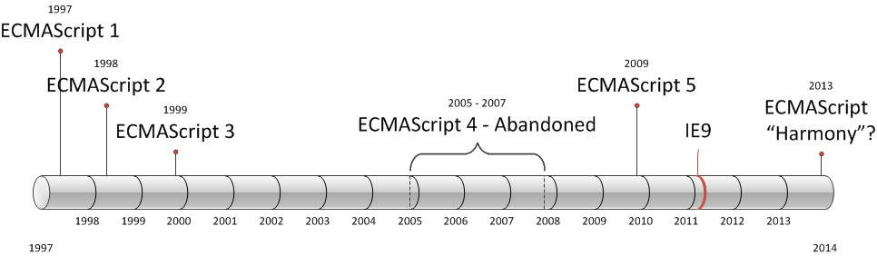
ECMAScript Versions

Slide 13
Syntax

Slide 14
C-style syntax
Similar to C, C++, Java, C#,
but with…
function everything() {
var x = {a:10}, y = [1,2], z = function() { };
for(var p in x) {
lbl: for(var i = 0; i < 10; i++) {
switch(x[p]) {
case 0: continue; default: break lbl;
}
}
if(x instanceof String || 'a' in x) delete x.a;
}
while(true) {
if(true) {
this.x = 3 / (-this.f()) ? /foo/g : new String("hello")
} else {
do { try { throw 3; } catch(e) { debugger; return; } finally {}}
while(false);
} } }
for..in
Object, Array, and Function literals
Automatic semicolon insertion
Regular expressions

Slide 15
Case-sensitivity
Everything is case-sensitive:
Variables
Function names
Operators

Slide 16
Identifiers
An identifier is the name of a variable, function, property, or function argument.
The first character must be a letter, an underscore (_), or a dollar sign ($).
All other characters may be letters, underscores, dollar signs, or numbers.
By convention, ECMAScript identifiers use camel case (i.e. myCar, doTest)

Slide 17
Comments
ECMAScript uses C-style comments for both single-line and block comments.
//single line comment
Or
/*
* This is a multi-line
* Comment
*/

Slide 18
Statements
Statements in JS are terminated by a semicolon.
Omitting the semicolon makes the parser determine where the end of a statement occurs.
//valid – preferred.
var diff = a - b;
//valid even without a semicolon - not recommended.
var sum = a + b

Slide 19
Strict Mode
ECMAScript 5 introduced the concept of strict mode.
Strict mode helps out in a couple ways:
It catches some common coding bloopers, throwing exceptions.
It prevents, or throws errors, when relatively “unsafe” actions are taken (such as gaining access to the global object).
It disables features that are confusing or poorly thought out.
"use strict";
function doSomething(){
"use strict";
//function body
}

Slide 20
Keywords

Slide 21
Keywords
break do Instanceof typeof
case else new var
catch finally return void
continue for switch while
debugger* function this with
default if throw
delete in try

Slide 22
Reserved Words (3 Edition)
abstract enum int short
boolean export interface static
byte extends long super
char final native synchronized
class float package throws
const goto private transient
debugger implements protected volatile
double import public

Slide 23
Reserved Words (5 Edition)
Strict Mode
None strict Mode
implements package public
interface private static
let protected yield
class enum extends super
const export import

Slide 24
Variables

Slide 25
Variables
Loosely typed
The var operator to define a variable makes it local to the scope in which it was defined.
var message = "hi";
message = 100; //legal, but not recommended
function test(){
var message = "hi"; //local variable
}
test();
alert(message); //error!

Slide 26
Global Variable
Define a variable globally by simply omitting the var operator as follows:
function test(){
message = "hi"; // global variable
}
test();
alert(message); // “hi”

Slide 27
Multi Variable
If you need to define more than one variable, you can do it using a single statement, separating each variable with a comma like this:
var message = "hi",
found = false,
age = 29;

Slide 28
Data Types

Slide 29
Data Types
There are five simple data types (also called primitive types) in ECMAScript:
Undefined
Null
Boolean
Number
String
Object (unordered list of name-value pairs)

Slide 30
The typeof Operator
A typeof operator determine the data type of a given variable.
The typeof can’t distinguish between objects.
typeof undefined // "undefined"
typeof 0 // "number"
typeof true // "boolean"
typeof "foo" // "string"
typeof {} // "object"
typeof null // "object"
typeof function () { } // "function"
typeof NaN // "number"
official mistake
Functions are still objects.
Not-A-Number

Slide 31
The Undefined Type
When a variable is declared using var but not initialized, it is assigned the value of undefined
var message;
alert( message == undefined ); //true
alert(message); //"undefined“
//make sure this variable isn’t declared
//var age
alert(age); //causes an error
alert( typeof message ); //"undefined"
alert( typeof age ); //"undefined"

Slide 32
The Null Type
The Null type is the second data type that has only one value: the special value null.
A null value is an empty object pointer, which is why typeof returns “object”
The value undefined is a derivative of null, so ECMA-262 defines them to be superficially equal.
var car = null;
alert(typeof car); //"object"
alert(null == undefined); //true

Slide 33
The Boolean Type
Note that the Boolean literals true and false are case-sensitive.
To convert a value into its Boolean equivalent, the special Boolean() casting function is called.
The if statement, automatically perform this Boolean conversion.
var message = "Hello world!";
if (message) {
alert("Value is true");
}

Slide 34
The Number Type
Number uses the IEEE-754 format to represent both integers and floating-point values.
var intNum = 55; //integer
var octalNum1 = 070; //octal for 56
var hexNum1 = 0xA; //hexadecimal for 10
var floatNum2 = 0.1;
var floatNum3 = .1; //valid, but not recommended
var floatNum1 = 1.; // interpreted as integer 1
var floatNum2 = 10.0; //whole number - interpreted as integer 10

Slide 35
Floating-Point Values
Accurate up to 17 decimal places but are far less accurate in arithmetic computations than whole numbers.
For instance, adding 0.1 and 0.2 yields 0.30000000000000004 instead of 0.3.
if (a + b == 0.3){ //avoid!
alert("You got 0.3.");
}

Slide 36
Range of Values
Number.MIN_VALUE = 5e-324
Number.MAX_VALUE = 1.7976931348623157e+308
Out of range = Infinity
NaN - Not a Number , which is used to indicate when an operation intended to return a number has failed
var result = Number.MAX_VALUE + Number.MAX_VALUE;
alert( isFinite(result) ); //false
alert( NaN == NaN ); //false
alert( isNaN(NaN) ); //true
alert( isNaN(10) ); //false
alert( isNaN("10") ); //false
alert( isNaN("blue") ); //true
alert( isNaN(true) ); //false

Slide 37
Number Conversions
There are three functions to convert nonnumeric values into numbers:
Number() --> Any data type to number
parseInt() --> string to number
parseFloat() --> string to number
var num1 = Number("Hello world!"); //NaN
var num2 = Number(""); //0
var num3 = Number("000011"); //11
var num4 = Number(true); //1
var num1 = parseInt("1234blue"); //1234
var num2 = parseInt(""); //NaN
var num3 = parseInt("0xA"); //10 - hexadecimal
var num4 = parseInt(22.5); //22
var num5 = parseInt("70"); //70 - decimal
var num6 = parseInt("0xf"); //15 - hexadecimal

Slide 38
The String Type
Represents a sequence of zero or more 16-bit Unicode characters.
Strings are immutable in ECMAScript, meaning that once they are created, their values cannot change.
var firstName = "Eyal";
var lastName = 'Vardi';
"a string" == "a string"

Slide 39
The Object Type
Everything else, Including functions.
Each Object instance has the following properties and methods:
Constructor
hasOwnProperty(propertyName)
isPrototypeOf(object)
propertyIsEnumerable(propertyName)
toLocaleString()
toString()
valueOf()

Slide 40
The Function Type (Object)
First class object
Can be defined inside other functions.
Functions stored in objects
Functions that don’t specify a return value actually return the special value undefined.
function foo() {}
// Option 2
var foo = function foo() {};
// Option 3
var foo = new Function( [argname1, [... argnameN,]] body );

Slide 41
Arguments
An ECMAScript function doesn’t care how many arguments are passed in, nor does it care about the data types of those arguments.
This happens because arguments in ECMAScript are represented as an array internally.
An arguments object that can be accessed while inside a function to retrieve the values of each argument that was passed in.
function sayHi() {
alert("Hello " + arguments[0] + ", " + arguments[1] );
}

Slide 42
Arguments Example
function doAdd() {
if (arguments.length == 1) {
alert(arguments[0] + 10);
} else if (arguments.length == 2) {
alert(arguments[0] + arguments[1]);
}
}
doAdd(10); //20
doAdd(30, 20); //50

Slide 43
No Overloading
ECMAScript functions cannot be overloaded in the traditional sense.
function addSomeNumber(num) {
return num + 100;
}
function addSomeNumber(num) {
return num + 200;
}
var result = addSomeNumber(100); //300

Slide 44
Function Properties & Methods
length
prototype
apply()
call()

Slide 45
Function Length Property
function sayName(name){ alert(name); }
function sum(num1, num2){ return num1 + num2; }
function sayHi() { alert("hi"); }
alert( sayName.length ); //1
alert( sum.length ); //2
alert( sayHi.length ); //0

Slide 46
Operators

Slide 47
Increment / Decrement
var num1 = 2;
var num2 = 20;
var num3 = --num1 + num2; //equals 21
var num4 = num1 + num2; //equals 21
var num1 = 2;
var num2 = 20;
var num3 = num1-- + num2; //equals 22
var num4 = num1 + num2; //equals 21

Slide 48
Unary Plus and Minus
The unary plus is represented by a single plus sign (+) placed before a variable and does nothing to a numeric value.
When the unary plus is applied to a nonnumeric value, it performs the same conversion as the Number() casting function.
var num = 25;
num = +num; //still 25

Slide 49
Unary Plus and Minus
var s1 = "01";
var s2 = "1.1";
var s3 = "z";
var b = false;
var f = 1.1;
var o = {
valueOf: function() {
return -1; }
};
s1 = +s1; //value becomes numeric 1
s2 = +s2; //value becomes numeric 1.1
s3 = +s3; //value becomes NaN
b = +b; //value becomes numeric 0
f = +f; //no change, still 1.1
o = +o; //value becomes numeric -1

Slide 50
Bitwise Operators
NOT - ~
AND - &
OR - |
XOR - ^
Left Shift <<
Right Shift >>
Unsigned Right Shift >>>

Slide 51
Bitwise Operators
var num = -18;
alert(num.toString(2)); //”-10010”
// Not
var num1 = 25; //binary 00000000000000000000000000011001
var num2 = ~num1; //binary 11111111111111111111111111100110
alert(num2); //-26
// And
var result = 25 & 3;
alert(result); //1
// XOR
var result = 25 ^ 3;
alert(result); //26
// OR
var result = 25 | 3;
alert(result); //27
// Left Shift
var oldValue = 2;
//binary 1000000 which is decimal 64
var newValue = oldValue << 5;

Slide 52
Boolean Operators
alert(!false); //true
alert(!"blue"); //false
alert(!0); //true
alert(!NaN); //true
alert(!""); //true
alert(!12345); //false
Not
And - &&
OR - ||

Slide 53
Equality Operators
Performed conversions into like types before doing a comparison.
Not equal because different data types
7 == "7" // true
7 === "7" // false

Slide 54
Statement

Slide 55
Statements
If
Do-while
For
For – in
Labeled statements
Break & Continue
With
Switch

Slide 56
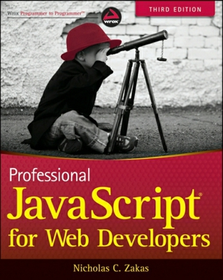
Resources
Professional JavaScript for Web Developers
Good links:
http://eyalvardi.wordpress.com/resources/html-5-course-resourses/javascript/

Slide 57
Thanks
eyalvardi.wordpress.com
Eyal Vardi
Microsoft MVP ASP.NET blog: eyalvardi.wordpress.com

